Slide 1
OSI MODEL
Open System Interconnection

Slide 2
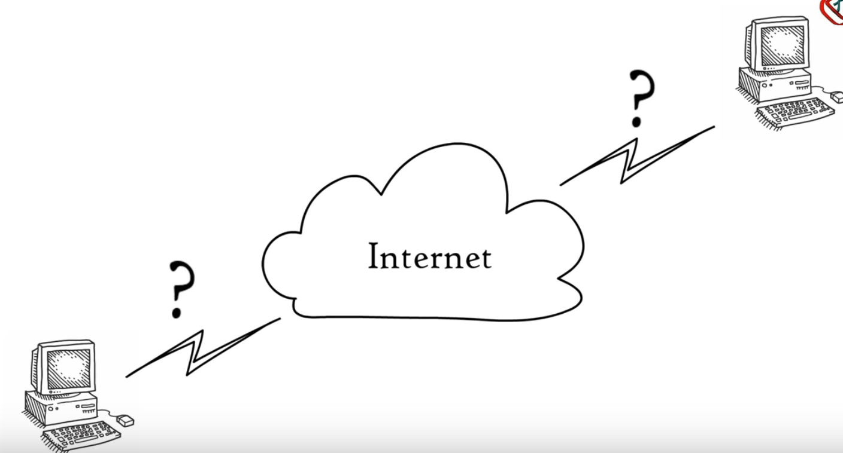
The Open Systems Interconnection (OSI) model describes seven layers that computer systems use to communicate over a network
It divides the process of communication into seven distinct layers, each with specific responsibilities.

Slide 3
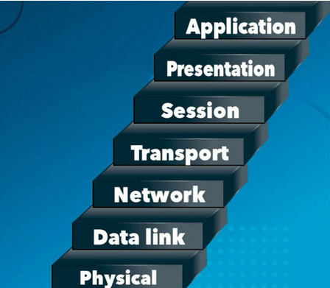

Slide 4



PLANNING A BIRTHDAY PARTY FOR YOUR MUM
You are responsible for cakes and chocolates
Your sister is responsible for return gifts to give to your guests
Your dad is responsible for arranging the food at the party

Slide 5
If there is a problem with the food at the party, whom will you go and look for?
Because Dad is responsible for the food at the party.
DAD

Slide 6

Because each person had their OWN responsibilities
The same happens in the OSI Model also

Slide 7
OSI MODEL
DATA TRANSMISSION PROCESS
7 Layers
Each Layer has its “OWN NAME” and “ITS RESPONSIBILITIES”
Each layer is a package of Protocols

Slide 8
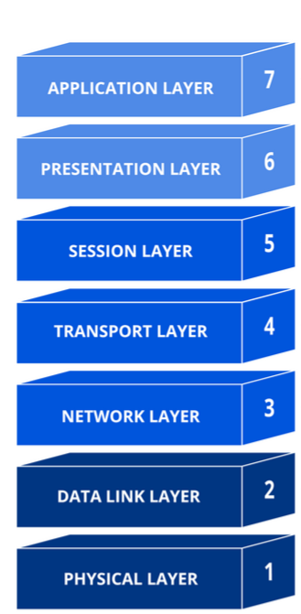
7 Layers of OSI
R
E
C
E
I
V
E
R
S
E
N
D
E
R

Slide 9
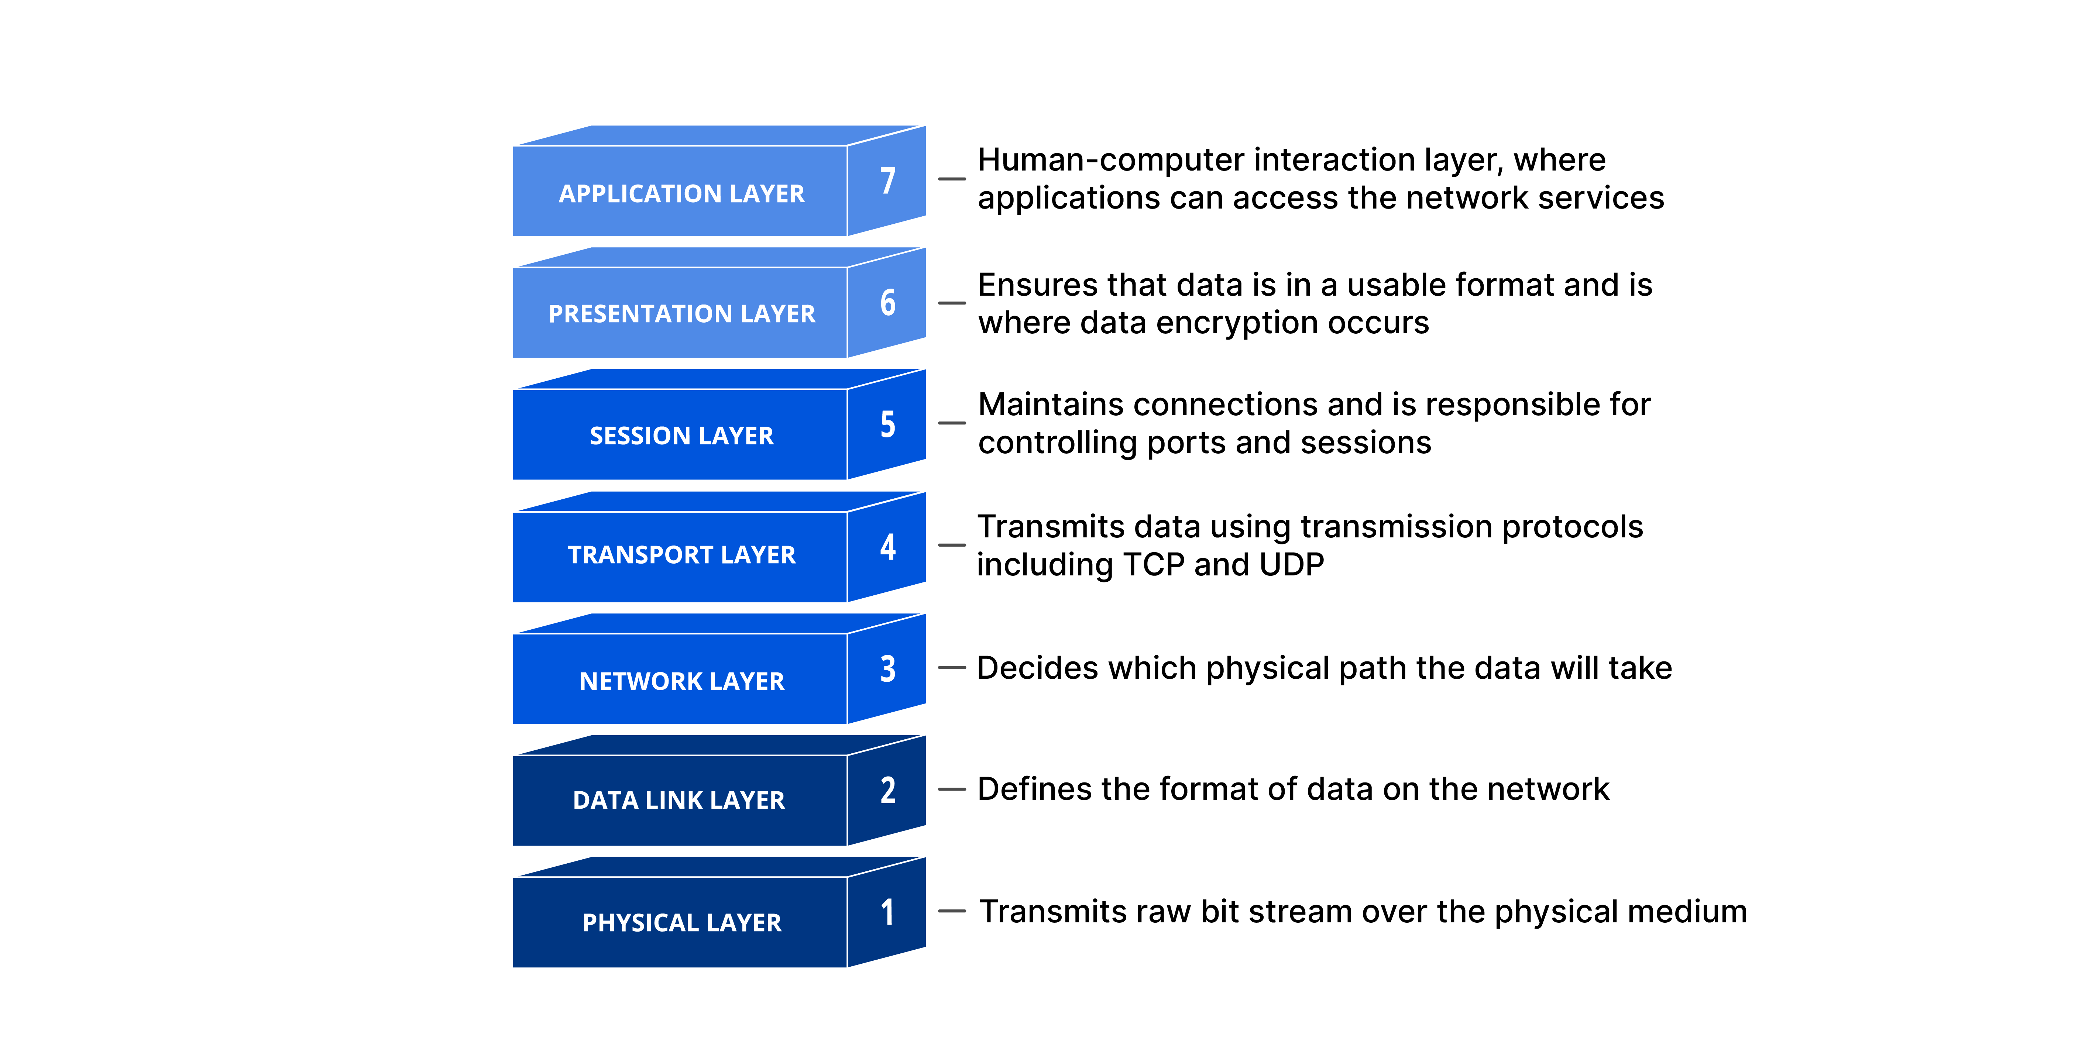

Slide 10




APPLICATION LAYER
Application layer is the closest layer to the end user
Application layer is used by network application
Network application means computer application that uses internet

Slide 11
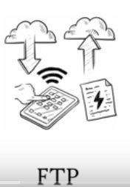

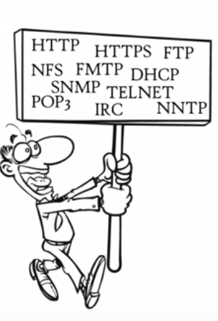


APPLICATION LAYER PROTOCOLS
File Transfer
Emails
Web Surfing
Virtual terminals

Slide 12
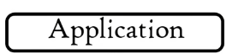

PRESENTATION LAYER
Presentation layer receives data from the application layer in the sender’s side and from the session layer in the receiver’s side
Ensures data is in a readable format for the session layer
This layer translates, encrypts, or compresses data to ensure that the information sent and received can be understood by the application

Slide 13
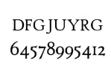
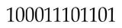
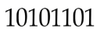
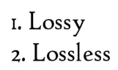
PRESENTATION LAYER
Translation
Compression
Numbers
Binary formats

Slide 14
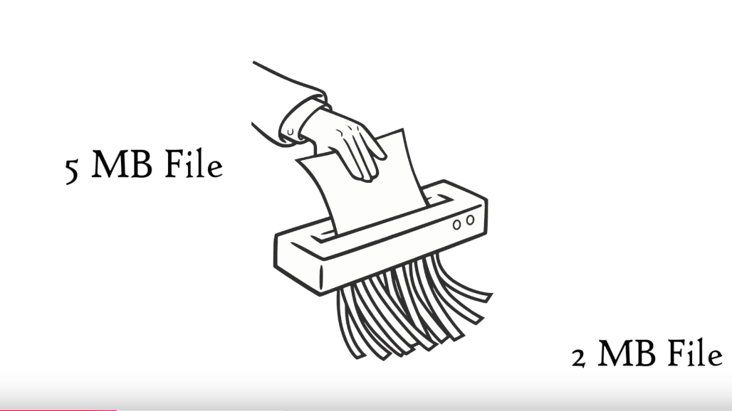
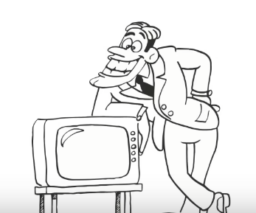

PRESENTATION LAYER
COMPRESSED DATA CAN BE TRANSMITTED AT A FASTER RATE
DATA COMPRESSION IS HELPFUL IN REALTIME VIDEO AND AUDIO STREAMING

Slide 15

PRESENTATION LAYER
Translation
Compression
Encryption/Decryption
Ih$%jbjk*&

Slide 16

PRESENTATION LAYER
ENCRYPTION/ DECRYPTION
SENDER- ENCRYPTION
RECEIVER- DECRYPTION

Slide 17
PRESENTATION LAYER PROTOCOLS
SSL/TLS - (Secure Sockets Layer) / TLS (Transport Layer Security)
It is a cryptographic protocols used to secure communications over a computer network
2. JPEG - Joint Photographic Experts Group
It is an image compression standard used to reduce the file size
3. GIF - Graphics Interchange Format
It is a bitmap image format that supports lossless compression
4. XML- eXtensible Markup Language
It is a markup language used for encoding documents in a format that is both human-readable and machine-readable

Slide 18
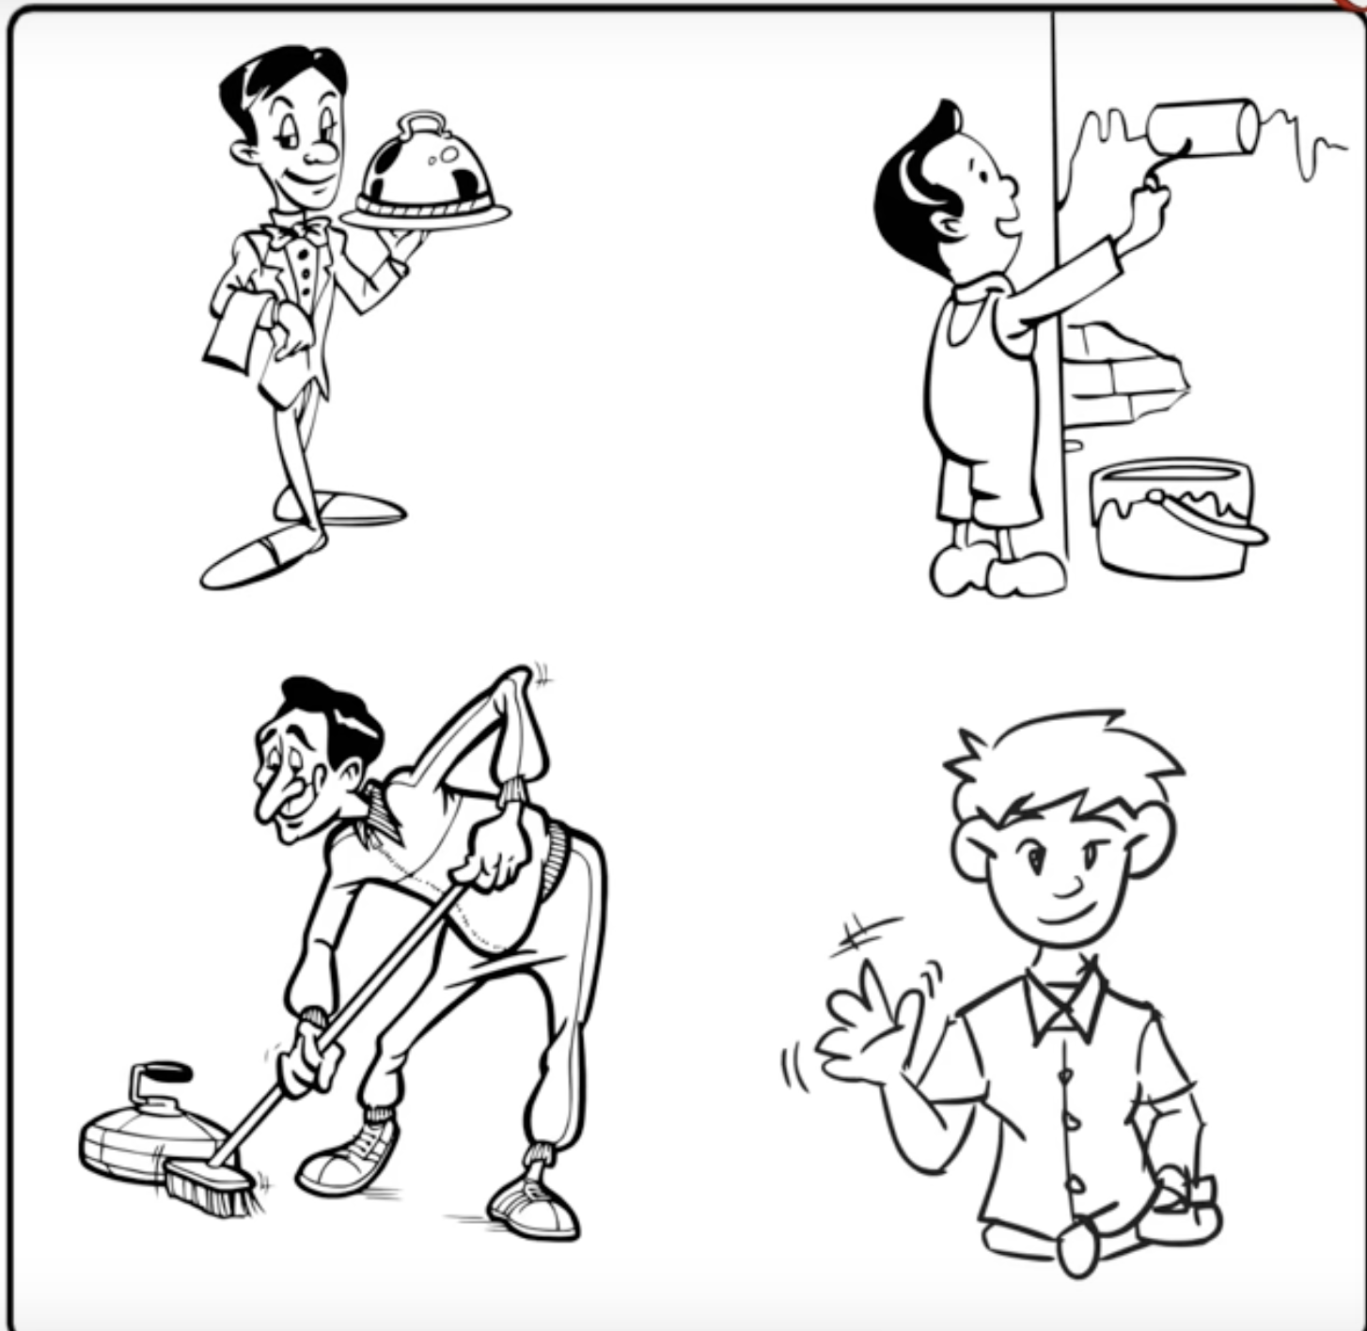
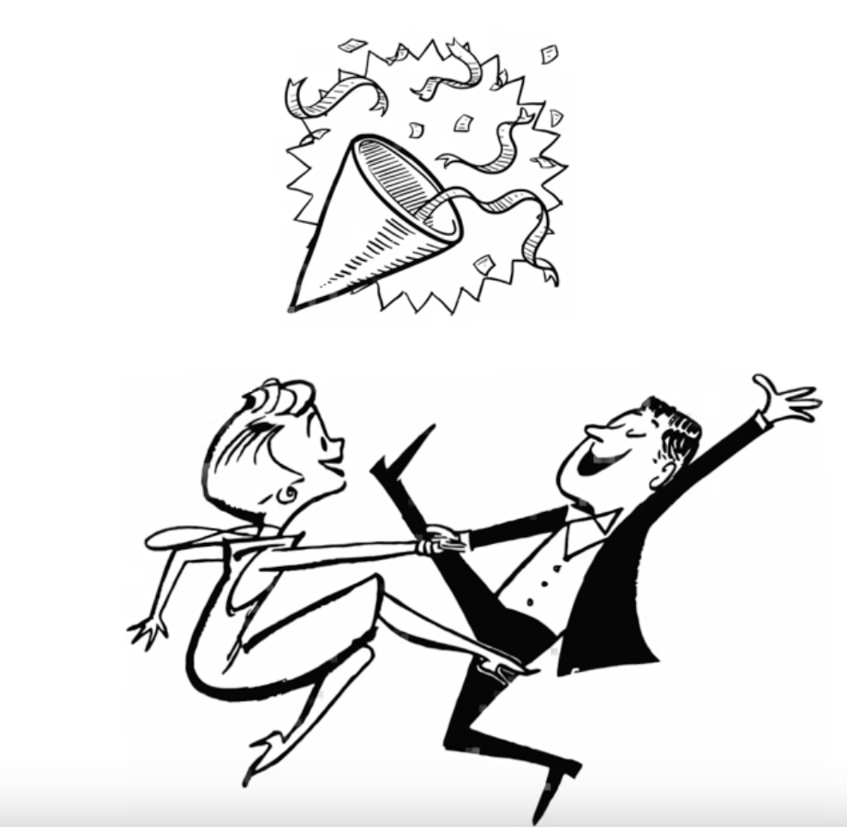
SESSION LAYER
You are hosting a party
You hire few helpers for setting up things in the party
The same happens in the session layer in setting up a session

Slide 19
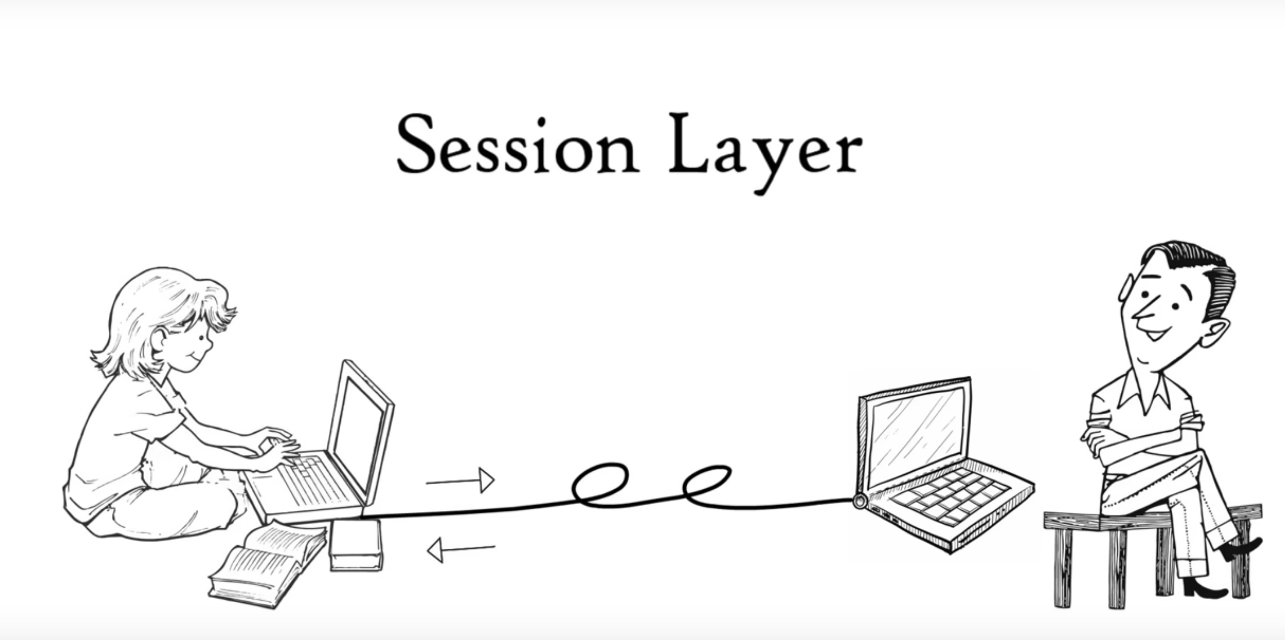
Session helps in setting up and managing connections enabling sending and receiving of data, followed by termination of sessions
APIs – Helpers of session layer

Slide 20
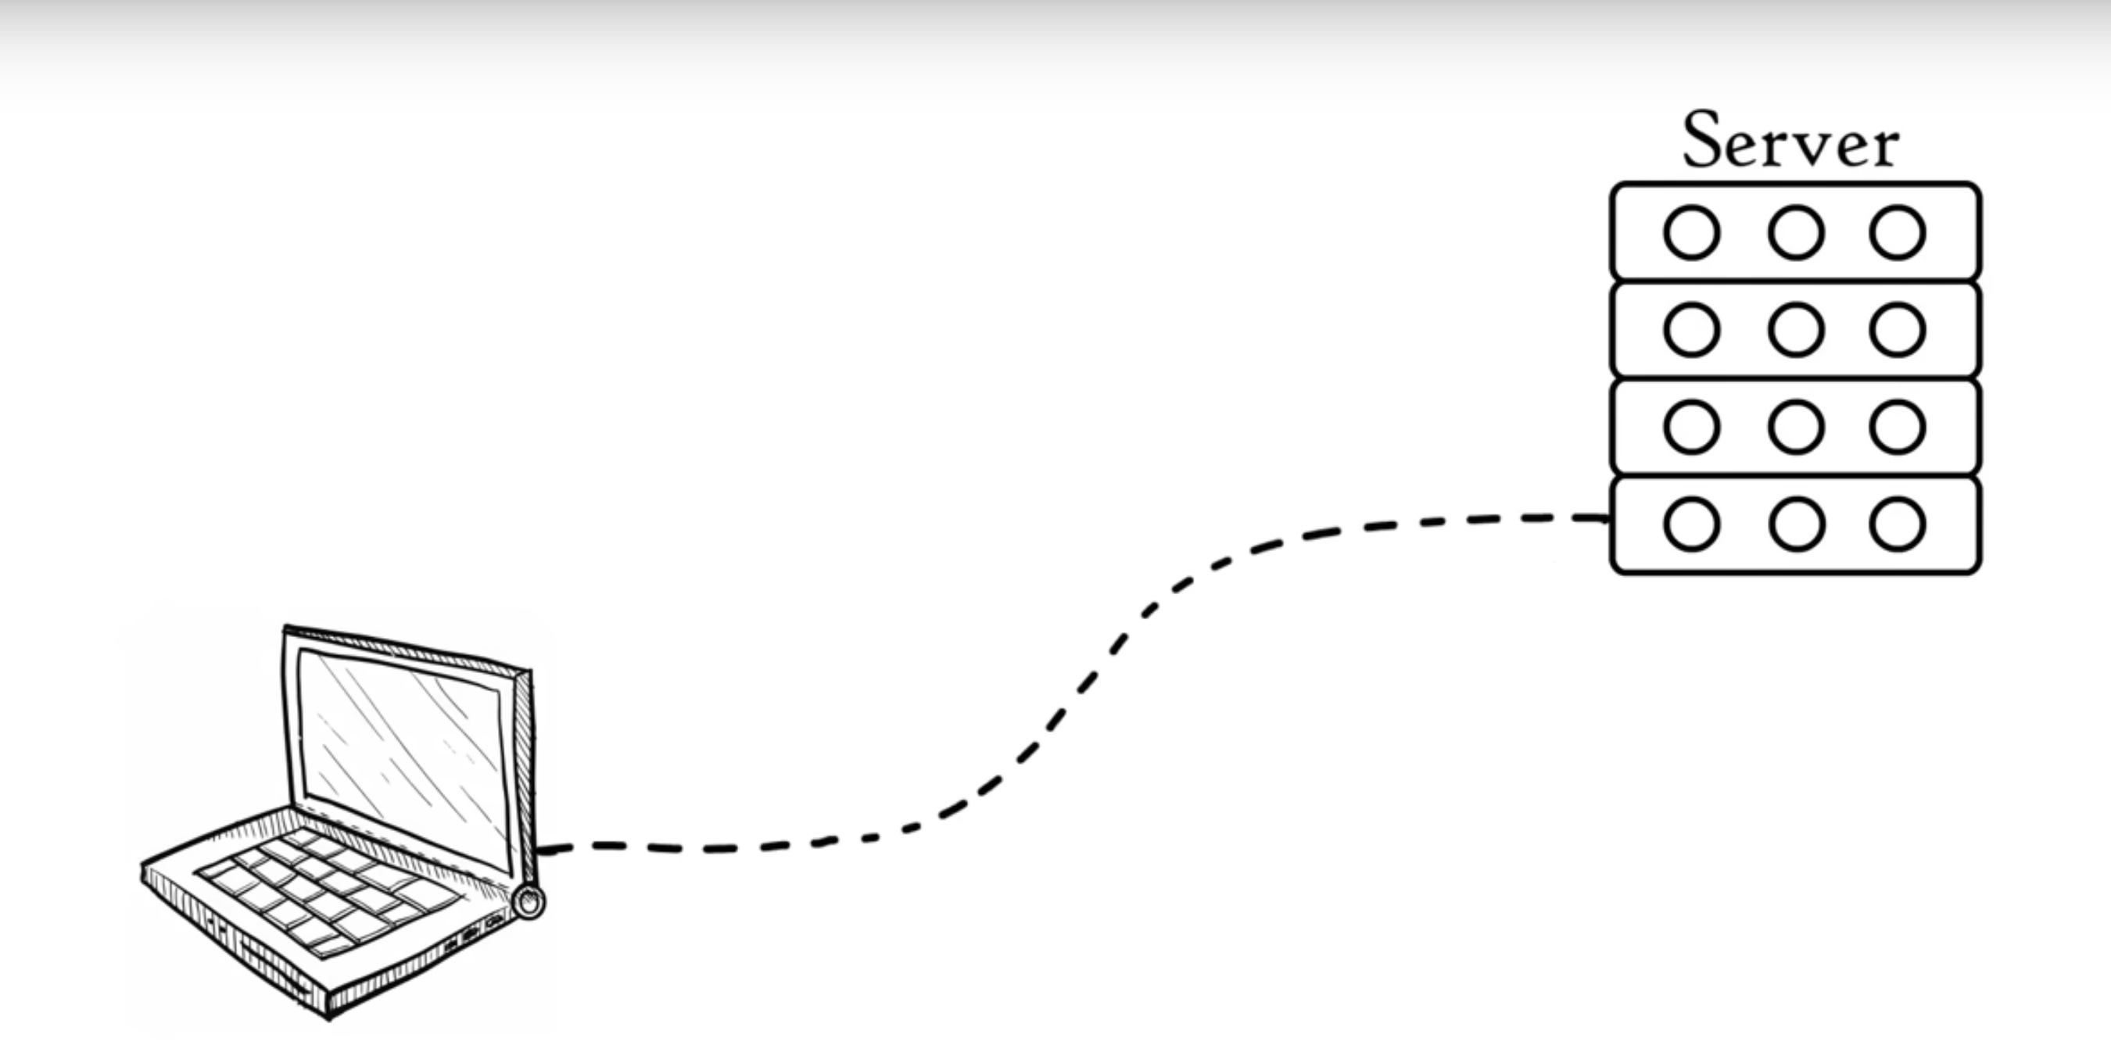



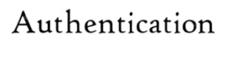

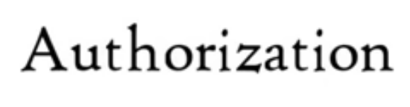


SESSION LAYER
Server performs Authentication ( who are you) and Authorization (Permission) in session layer
Session layer keeps a track of files that are being downloaded

Slide 21
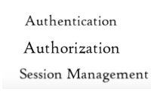
Session helps in setting up and managing connections enabling sending and receiving of data, followed by termination of sessions
APIs – Helpers of session layer

Slide 22
SESSION LAYER PROTOCOLS
PROTOCOLS IN SESSION LAYER
PROTOCOLS
FUNCTIONS
NetBIOS- Network Basic Input/Output System
Session Management
RPC- Remote Procedure calls
Remote Procedure Calls between systems
PPTP-Point-to-Point Tunneling Protocol
VPN Tunneling
SMB- Server Message Block
File/Printer Sharing

Slide 23
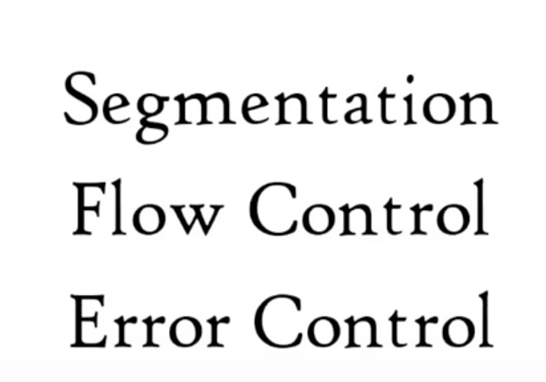
TRANSPORT LAYER
The transport layer is responsible for breaking data into smaller segments, ensuring error-free delivery, and maintaining reliable communication between systems
It performs the following functions

Slide 24
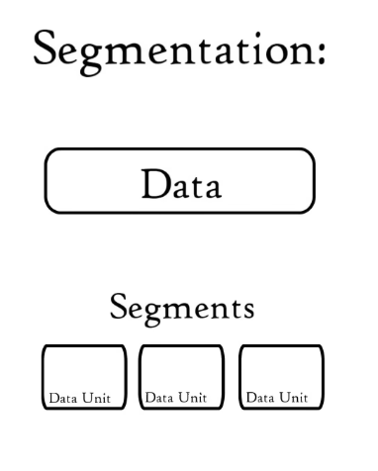
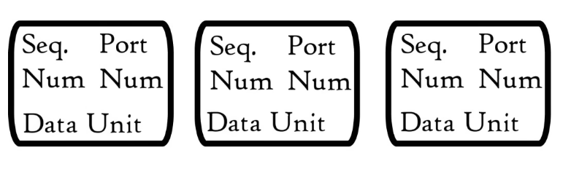
TRANSPORT LAYER
Segmentation refers to the process of breaking down large chunks of data into smaller, manageable pieces to facilitate easier transmission over a network
Port number and sequence number is added to each segment of data
Unit of data in the transport layer is Segments
DATA + PORT NUMBER + SEQUENCE NUMBER = SEGMENTS

Slide 25
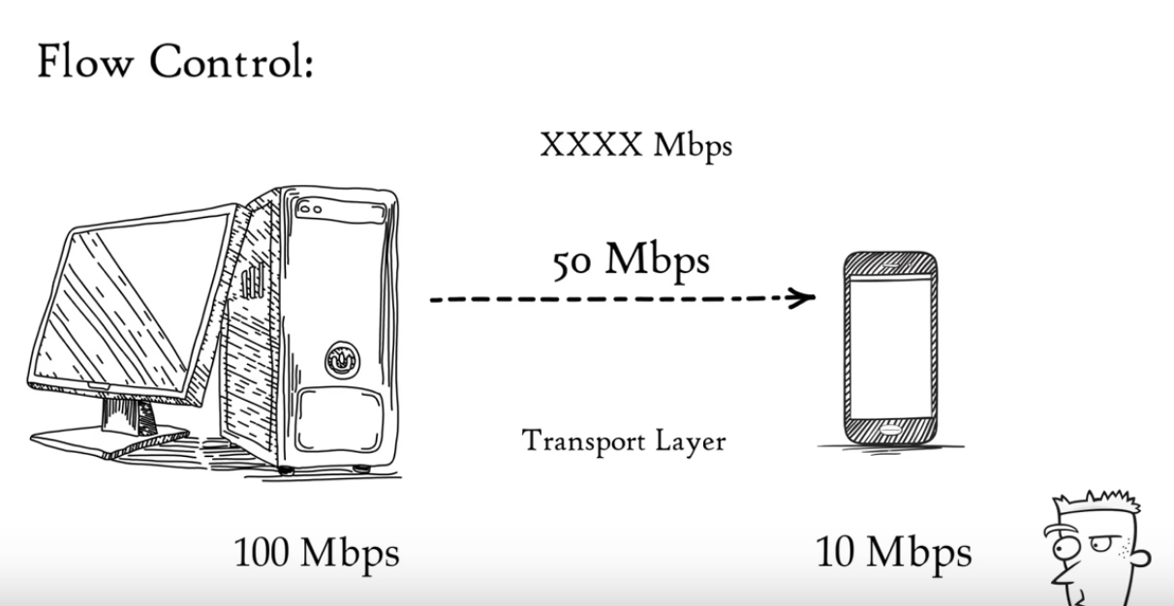
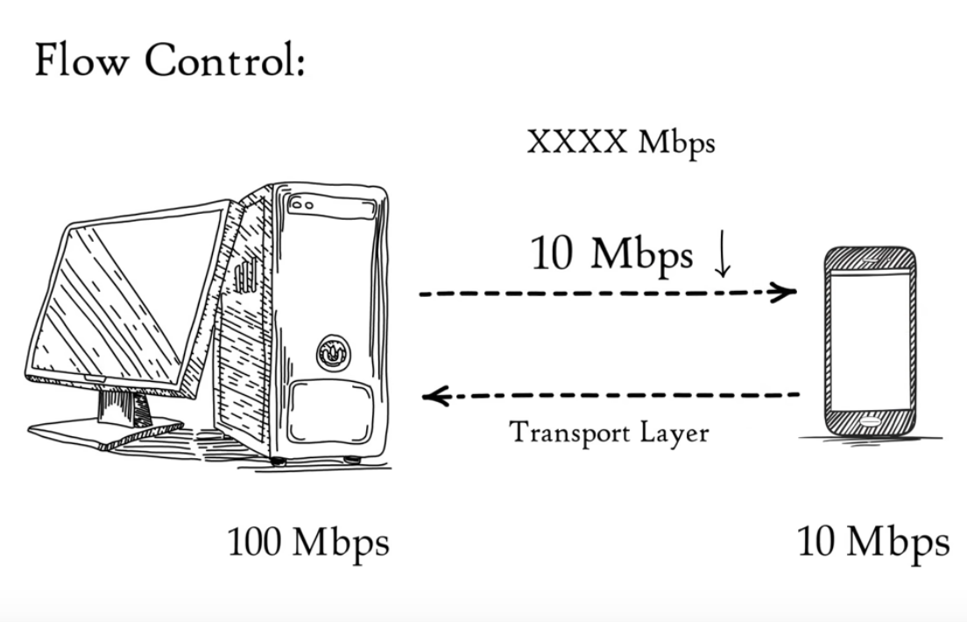
TRANSPORT LAYER
Flow control in the Transport Layer (Layer 4) of the OSI model is a mechanism that ensures data is transmitted at a rate that the receiving device (or application) can handle.
FLOW CONTROL

Slide 26
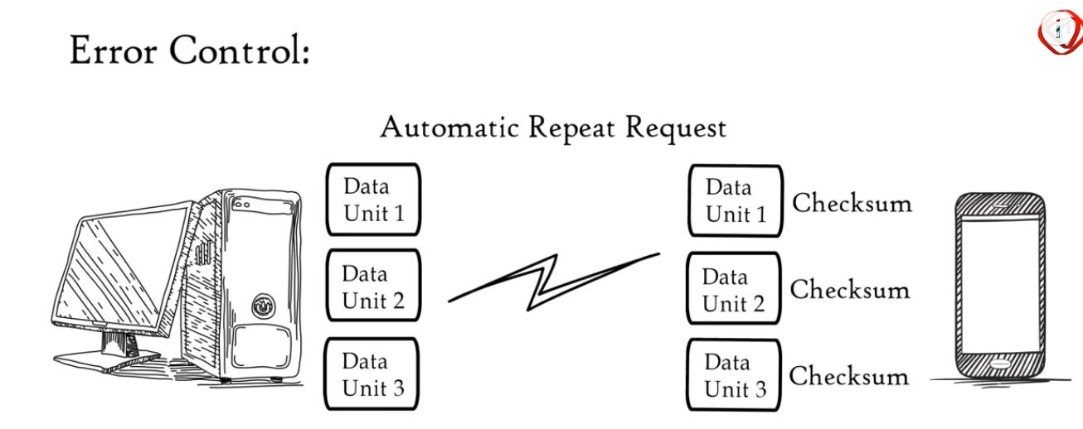
TRANSPORT LAYER
Error Control in the Transport Layer (Layer 4) refers to the mechanisms used to detect and recover from errors that occur during data transmission

Slide 27
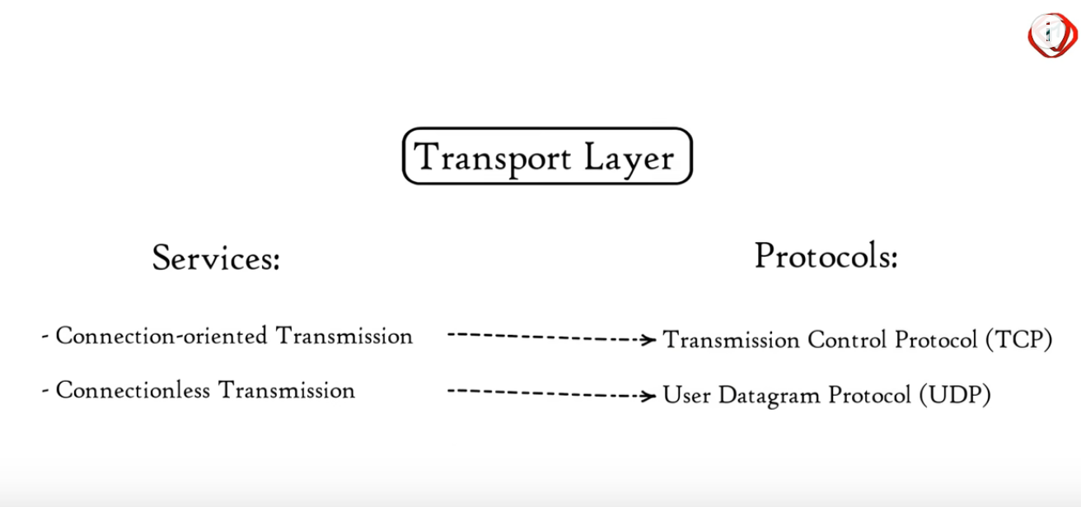
TRANSPORT LAYER PROTOCOLS

Slide 28
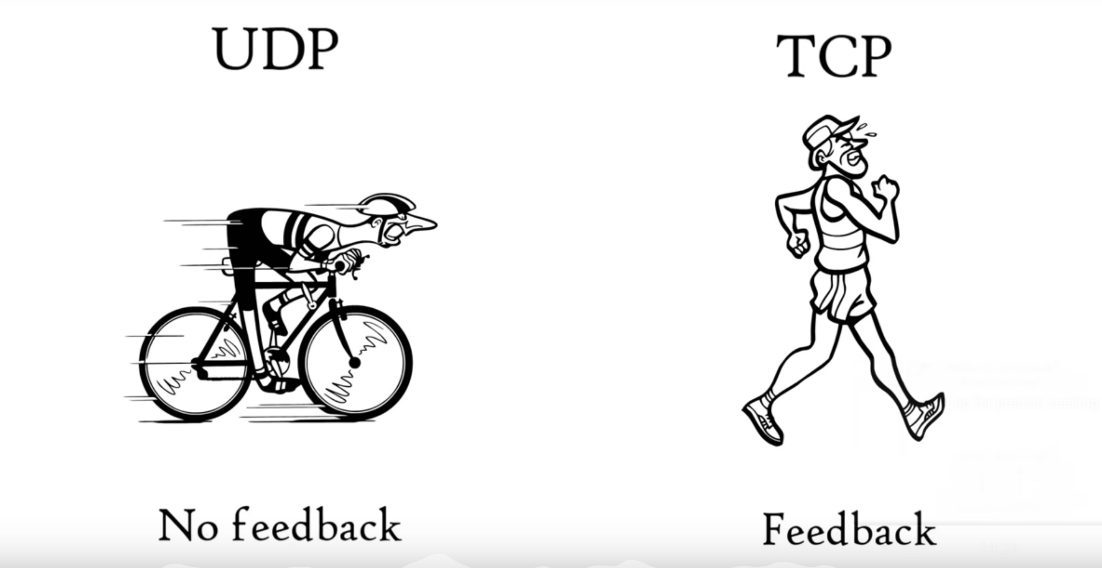
TRANSPORT LAYER
UDP is faster because it gets no feedback
TCP is slower because it gets feedback

Slide 29
TRANSPORT LAYER
UDP
TCP
UDP is used where is does not matter if all data is received or not
TCP is used where whole data delivery is a must
Example
1. Online streaming movies
2. Songs
3. Games
Example
1. Email

Slide 30
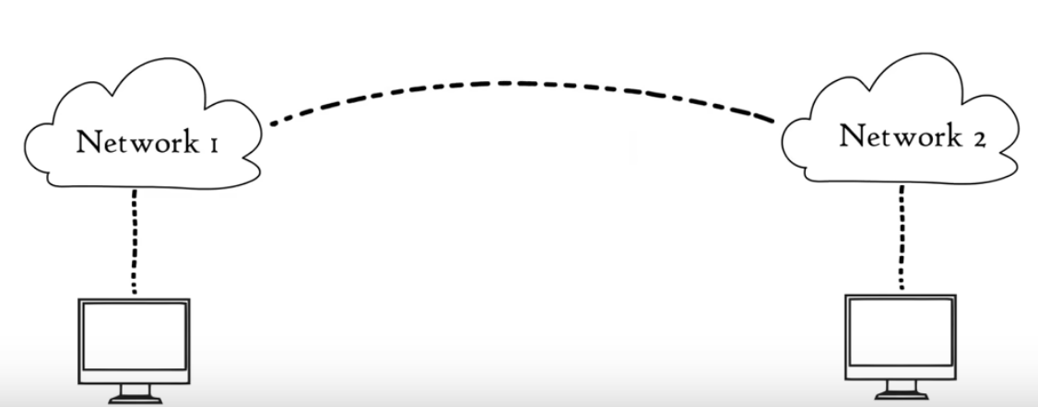
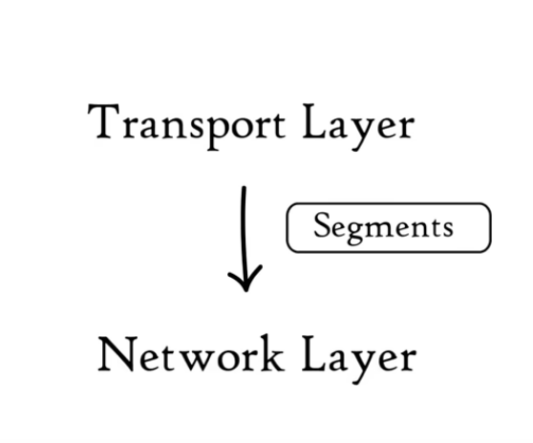
NETWORK LAYER
Network layer transfers the received data segments from one computer to another located in different networks

Slide 31
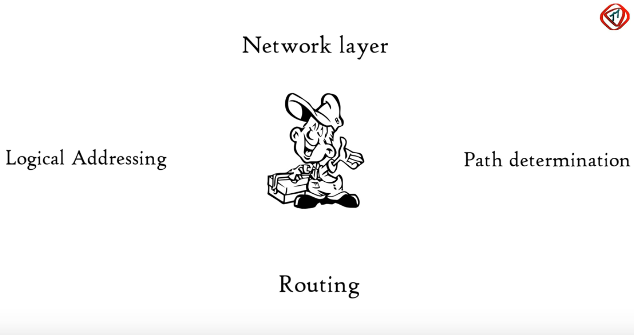
NETWORK LAYER
3 FUNCTIONS OF NETWORK LAYER
1
2
3

Slide 32
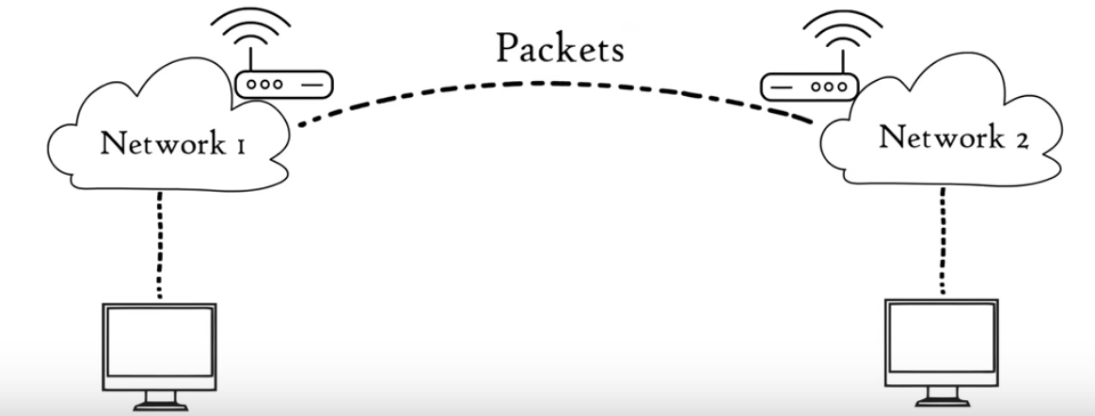
NETWORK LAYER
Data unit in the network layer is called packets
The routers reside in this layer

Slide 33
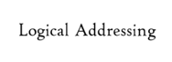
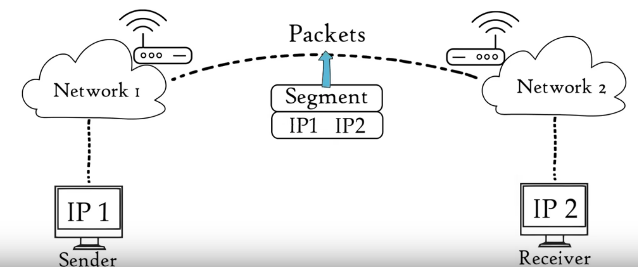
NETWORK LAYER
It is the process of assigning the IP addresses to the segments to from IP packets
SEGMENT + IP ADDRESS = DATA PACKET
It is assigned to ensure each data packet in reached to their correct destination

Slide 34
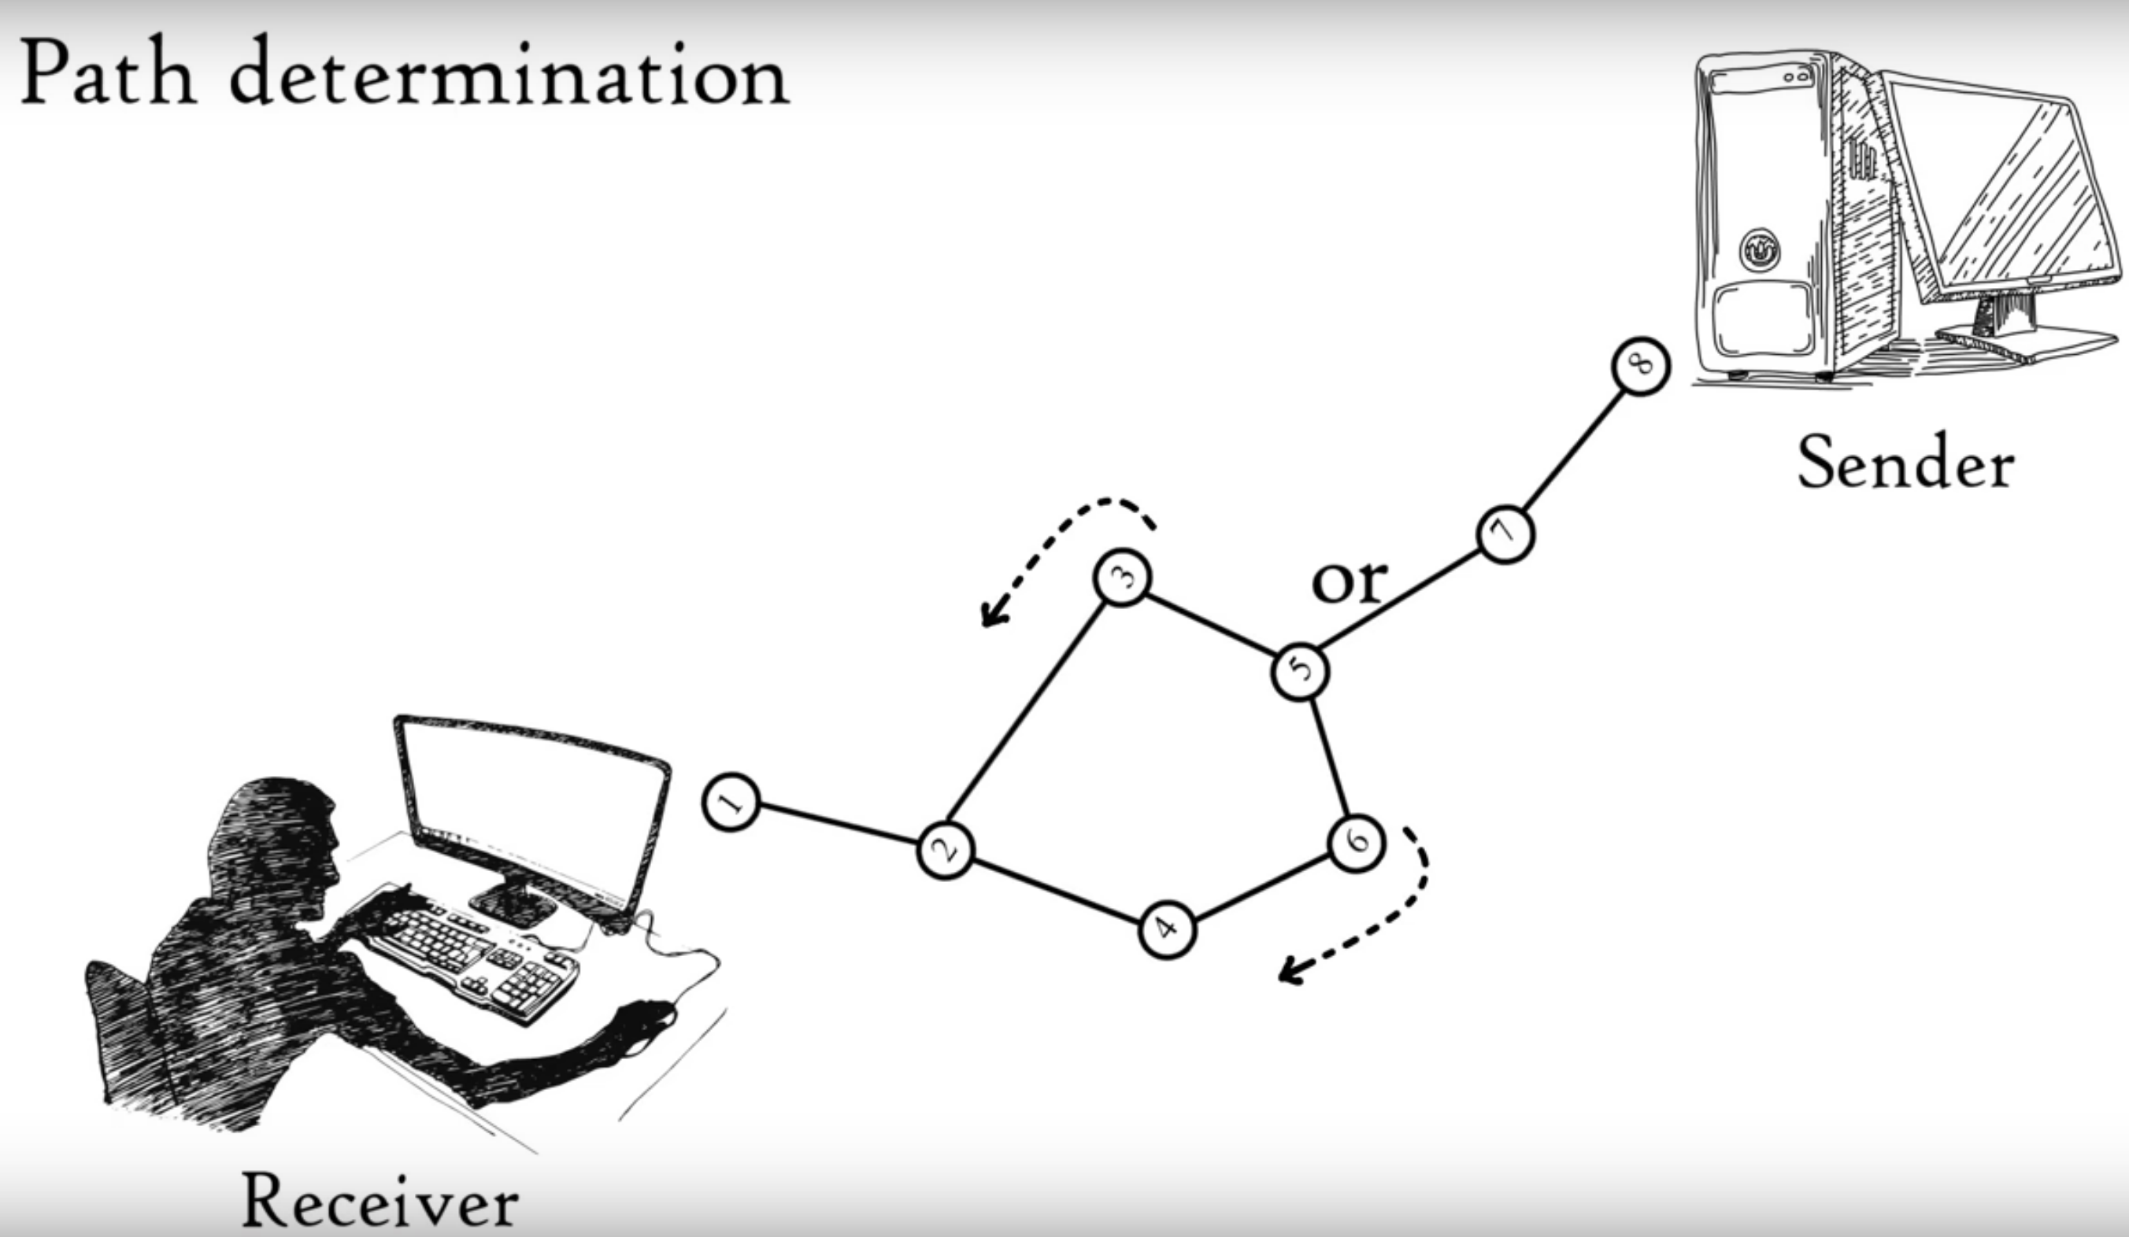
NETWORK LAYER
Path determination is the process of choosing the best possible path for data delivery from source to destination

Slide 35
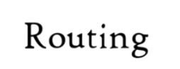

NETWORK LAYER
RoutIng is a method of moving a data packet from source to destination

Slide 36
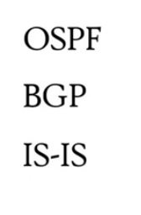
NETWORK LAYER PROTOCOLS
OSPF - Open Shortest Path First – Routing
BGP - Border Gateway Protocol - Inter-domain Routing
IS-IS - Intermediate System to Intermediate System - Routing

Slide 37
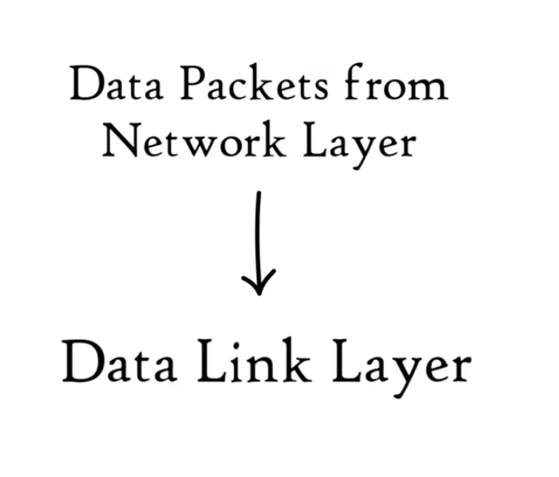
DATALINK LAYER
Datalink layer provides error-free transfer of data frames between devices on the same network.
Physical addressing is done at data link layer
DATA PACKET + MAC ADDRESS = FRAME
Data unit in the data link layer is called frame

Slide 38
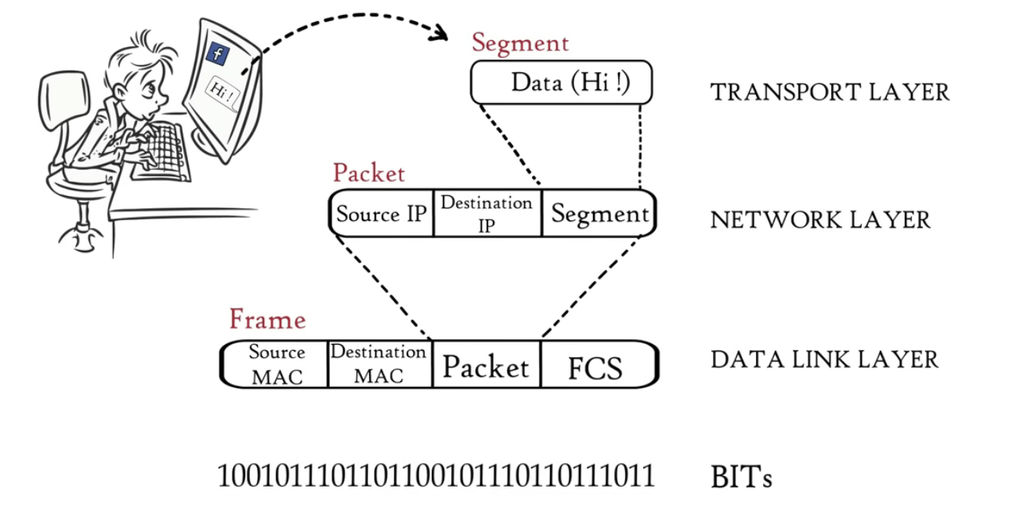
DATALINK LAYER
Data is transmitted in bits

Slide 39
DATALINK LAYER PROTOCOLS
Ethernet
Ethernet is both a protocol (specifying rules for data transmission) and a standard. It defines how devices communicate on a wired LAN
2. PPP (Point-to-Point Protocol)
PPP is a protocol used for point-to-point communication, typically for establishing direct links between two devices
3. HDLC (High-Level Data Link Control)
HDLC is a protocol for synchronous data transmission, widely used in serial communication links
4. Frame Relay
Frame Relay is a protocol used for WAN (Wide Area Network) connections, providing high-speed transmission of data across the network

Slide 40

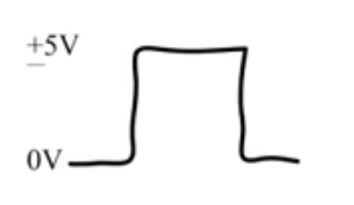

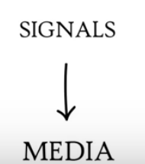
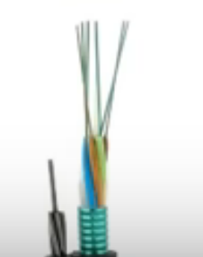
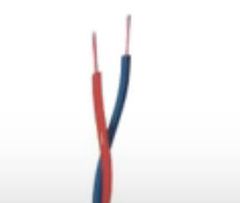

PHYSICAL LAYER
The physical layer is responsible for the transmission and reception of raw data (bits) over a medium, such as copper cables((electrical signal), fibre optic cables(light signal), or air(radio waves)
Signals generated by the physical layer will depend on the type of media which is used to connect 2 devices

Slide 41
PHYSICAL LAYER PROTOCOLS
1. DSL (Digital Subscriber Line)
DSL is a physical layer protocol used for transmitting digital data over telephone lines using different frequencies for voice and data transmission
2. USB (Universal Serial Bus)
USB is a physical layer protocol that defines the voltage levels, signal timings, and connectors for transferring data between a host and peripheral devices.
3. Bluetooth
Bluetooth is a wireless protocol that defines the radio frequencies and modulation techniques for short-range communication between devices, such as smartphones, laptops, and peripherals
4. Wi-Fi
Wi-Fi defines the radio waves, frequencies, and modulation used for wireless data transmission in local area networks (WLANs)

